Slide 1
Arithmetic Logic Unit
ALU

Slide 2
Project Members:
Yassmine Ahmed abdl-basset
Menna Ashraff
Amira Ibrahim
Sultan Ibrahim
Anas Ahmed

Slide 3
Our ALU project can do three main operations:
Logic
Arithmetic
Shifting

Slide 4
ALU Operations:
ADD
SUBTRACT
MULTIPLY
INCREMENT(+1)
DECREMENT(-1)
AND
OR
XOR
NOT
SHIFTING
GRAY (OPTIONAL)

Slide 5
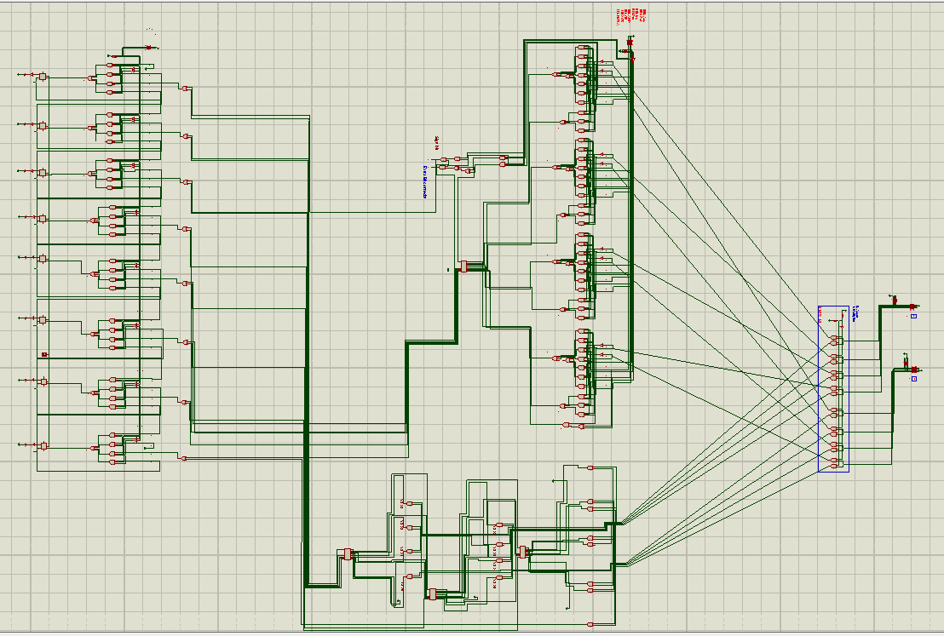
The design:

Slide 6
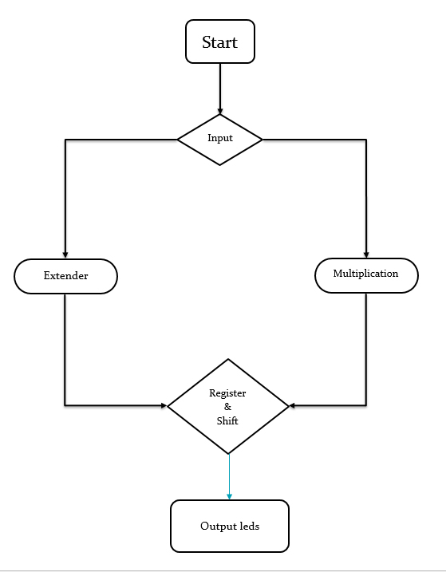
Flow Chart:

Slide 7
Quick overview.
First we take the input from the two 4-bit DIPSW_4.
The input is then applied to either the Extender or the MULTIPLIER circuit.
The circuit that we chose will calculate it’s out put and then the output will be applied to the Registers via OR gate.
The Registers will accept the new input (if chosen ) and will show it on 8-LEDs.

Slide 8
Extender:

Slide 9
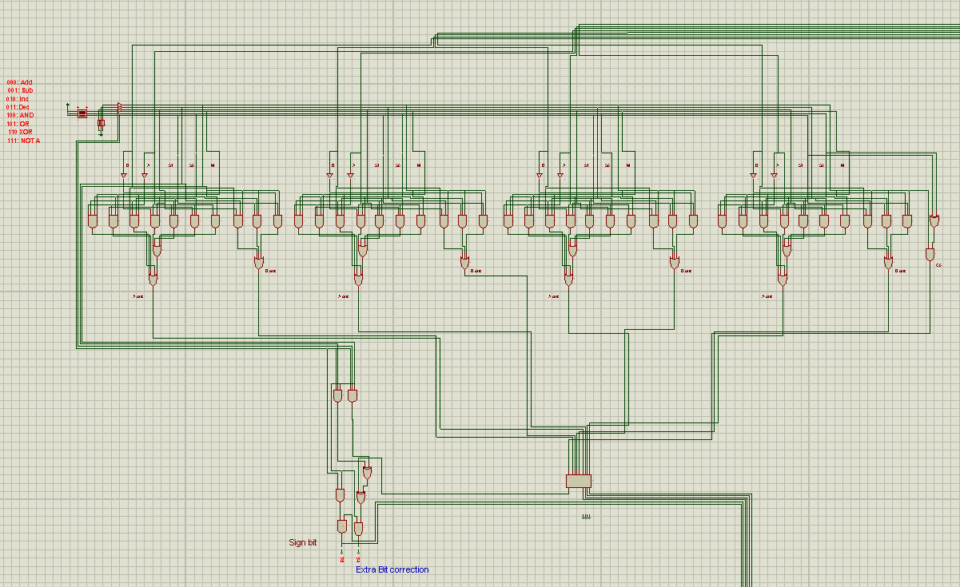
4-bit Extender with Full Adder and correction:

Slide 10
How it works?
The tow input number are applier to the extender.
We select the desired function by changing the selectors ( M,S0 and S1 ) values.
The extender manipulate the Full Adder input values to give an output that will satisfy the required operation.

Slide 11
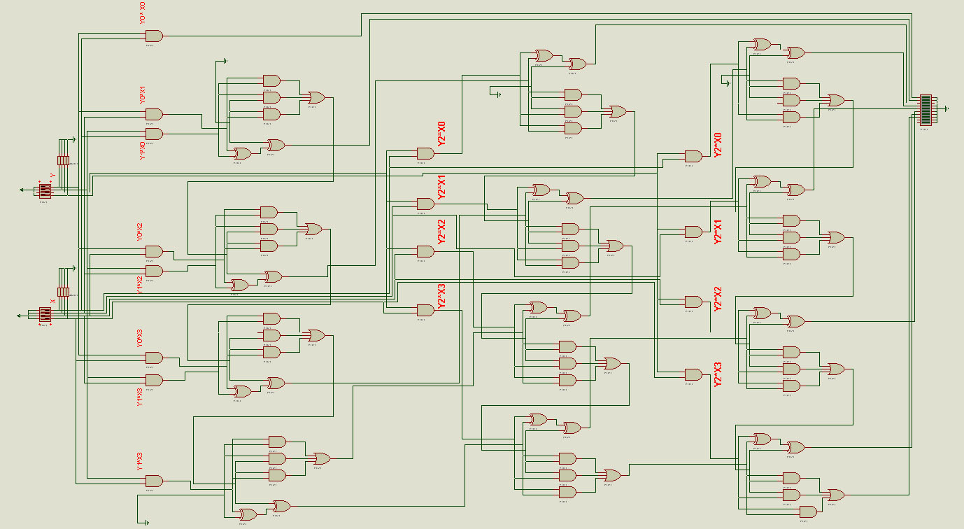
Multiplication:

Slide 12
How it works?
For 4x4 -> 8bit Maximum result.
It require 4x4=16 AND gates to generate this product.
The multiplication unite uses “multiplication by addition”.
It uses 3*(4-bit Full Adder)
 |  |  | X3 | X2 | X1 | X0
 |  |  | Y3 | Y2 | Y1 | Y0
 |  |  | Y0*X3 | Y0*X2 | Y0*X1 | Y0*X0
 |  | Y1*X3 | Y1*X2 | Y1*X1 | Y1*X0
 | Y2*X3 | Y2*X2 | Y2*X1 | Y2*X0
Y3*X3 | Y3*X2 | Y3*X1 | Y3*X0

Slide 13
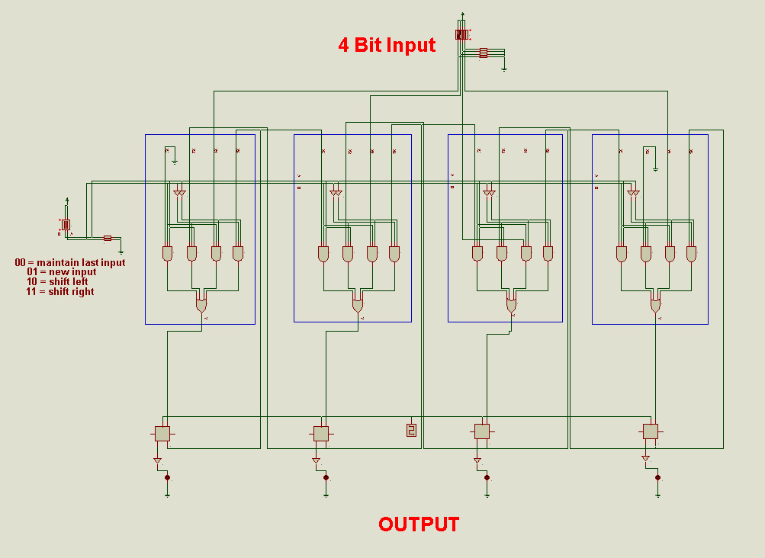
Shifting:

Slide 14
How it works?
As we are performing 4 operations: two switches needed (S0,S1)
To switch between operations : 4:1MUX is used.
S0 | S1 | Operation
0 | 0 | Maintain
0 | 1 | New input
1 | 0 | Shift right
1 | 1 | Shift left

Slide 15

Questions ?

Slide 16

Apology is in order.

